Slide 1
Approaches to Stress, Anxiety, and Depression
By: Kelly elker, Marie-Ève bonneau, and Shamaila aKRAM

Slide 2
Agenda
Prevalence of Anxiety and Depression
Treatments for Anxiety and Depression
Introduction to Mindfulness and Mindfulness Based Stress Reduction (MBSR)
Meditation
Yoga
Indigenous Approaches
Other therapeutic Interventions
Conclusion

Slide 3

Prevalence of Anxiety and Depression
Depression and anxiety are the two leading causes of disability worldwide (Manincor, et al., 2016).
More than 350 million people suffer from depression
Approximately 4.7% of the worlds population
Anxiety disorders are the most commonly diagnosed mental health issues (Anthony, et al., 2018)
Approximately 7.3% of the worlds population
Many diagnosed experience comorbidity between the two disorders (Kumara & Kumar, 2016).
Image courtesy of: https://www.mentalhealthns.ca/
calendar/2017/depression-screening-day
Statistics sourced from (Manincor, et al., 2016).

Slide 4


Stress, Anxiety, and Depression
Prolonged exposure to stress in daily life can have serious long term psychological effects (Galla, et al., 2015).
Psychological stress and related health disorders have increased as 44% of Americans stated an increase in stress over the past 5 years (Galla, et al., 2015).
Mindfulness-based stress reduction strategies have been increasing in popularity to combat persistent stress, anxiety, and depression
Image courtesy of: https://www.readersdigest.ca/health/healthy-living/20-things-you-need-know-about-stress/

Slide 5
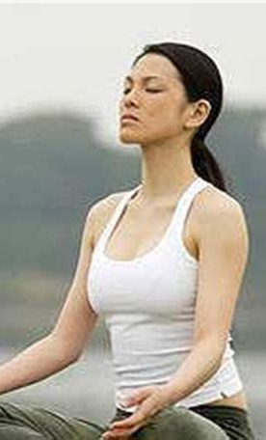
What is Mindfulness?
Mindfulness is the skill to nonjudgmentally observe emotions, sensations, or cognitions is moment-to-moment awareness and is trained through meditation exercises that have been adapted from Buddhist traditions (Bohlmeijer et al., 2010)
"Mindfulness is paying attention on purpose, in the present and non judgmentally" to the unfolding of experience moment by moment (Kabat-Zinn, 1990).
Mindfulness is to distinguish awareness from mental activity, it is to learn to be aware of our own mental states without being caught in them. (Kornfield, 2008)
Image courtesy of: https://www.thedailymeditation.com/wp-content/uploads/2014/04/anapanasati-breathing-meditation.jpg

Slide 6
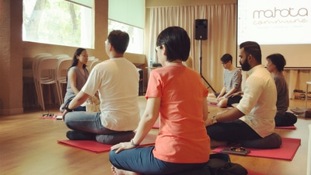
What is Mindfulness Based Stress Reduction? (MBSR)
Awareness of habitual patterns of thoughts and behaviors and, subsequently naturally quit those that are harmful (Kabat-Zinn, 1990)
Used for treatment of patients with psychological disorders, depressive symptoms and anxiety from chronic diseases.
A typical MBSR Program, consists of 8-10 sessions and has 30 participants
Developed originally for people with chronic pain, but currently being used for chronic diseases like cancer
Image courtesy of: http://www.inthepresent.sg/uploads/9/7/5/6/97566226/mbsr-orientation-photo-3.jpg

Slide 7
Effects of MBSR on Stress and Anxiety
Galla et al, 2015 found that community based mindfulness training program was successful to improve mindfulness, self-compassion, and perceived stress in participants with different life challenges.
Bohlmeijer et al., (2010), concluded that MBSR has minor improvement changes on patients with depression, anxiety, and psychological and suggested to integrate Cognitive Behavioural Therapy with MBSR.
Mindfulness can be incorporated into other therapies to enhance their effectiveness (Nagy & Baer, (2017)

Slide 8
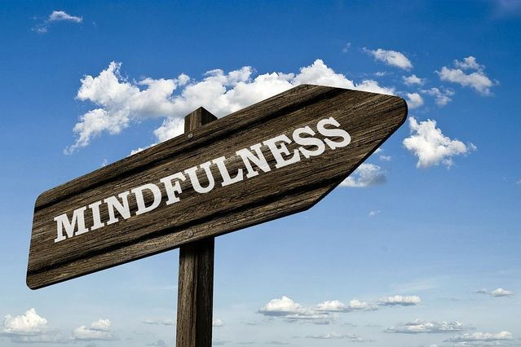
How Mindfulness Works?
Mindfulness practice helps to reduce cogitation (Campbell et al., 2012), enhances emotional control (Robins et al., 2012), and strengthens working memory.
Roemer and Orsillo (2009) explained working of mindfulness as under;
Mindfulness enriches healthy relationship to thoughts and feelings, and brings more awareness and observance.
Mindfulness makes more nonjudgmental, non responsive, and compassionate of thoughts and feelings, and enhances acceptance of such inner experiences.
Such healthy relationship helps to engage in value added activities in presence of unpleasant thoughts and feelings
Image Courtesy of: https://www.psychologytoday.com/ca/blog/turning-straw-gold/201708/you-can-use-mindfulness-choose-how-live

Slide 9
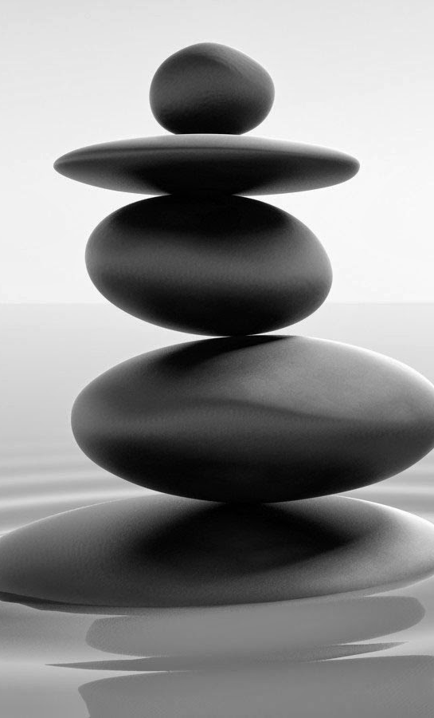
Meditation
Meditation, specifically the act of focusing the mind on something (e.g., an object, the breath, a mantra, or the moment) and gently steering the mind back to the task when it wanders, may likewise distract a person from a stressor and lead to quicker recovery (Borchardt & Zoccola, 2018)
Meditation is deliberate self-regulation of attention in the present moment and typically comprises concentration, relaxation, altered states of consciousness, suspension of logical thought, and maintenance of a self-observing attitude (Craven, 1989).
Meditation has also been defined as a practice that emphasizes maintaining alertness and expanding self-awareness with an increased sense of integration and cohesiveness (Snaith, 1998).
Image Courtesy of: http://4.bp.blogspot.com/-_gk9VoBkIeg/Upof24gbu1I/AAAAAAAAC9k/SC8muwaI8bA/s1600/Zen+Meditation+HD+1.jpg

Slide 10
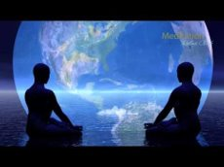
Meditation for Stress and Anxiety
Zeidan et al., (2010), conducted brief meditation on 63 participants of university of Carolina, Charlotte and concluded that it enhances sustained attention, improves cognition with the ability to control processing of thoughts, improves moods and reduces stress and anxiety
Coppola, (2007) conducted stress relief meditation on a group of 25 participant and found larger than expected impact on trait anxiety. However, proposed control group and correction for placebo component to further refine the results and get comparable with transcendental meditation.
Image courtesy of: https://www.bing.com/images/search?--meditation-for-anxiety-spiritual -

Slide 11
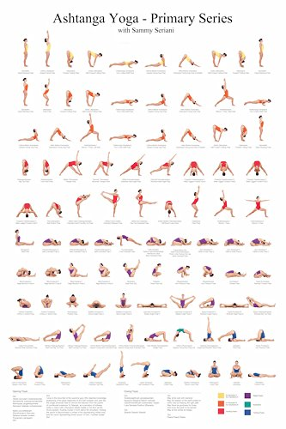
Yoga for Improved Well-being
Yoga is “a wholistic multidimensional system of health and wellbeing that focuses on the mind and its functions, with multicomponent mind‐body practices, including: (1) physical postures and movement; (2) breathing exercises; (3) relaxation; and (4) mindfulness and meditation” (Manincor, et al., 2016).
Additionally, yoga includes cultivation of positive values, thoughts, attitudes, and lifestyle considerations (Manincor, et al., 2016).
Image courtesy of: https://www.amazon.com/
Ashtanga-Primary-Series-Practice-Chart/dp/B0081YWJIS

Slide 12
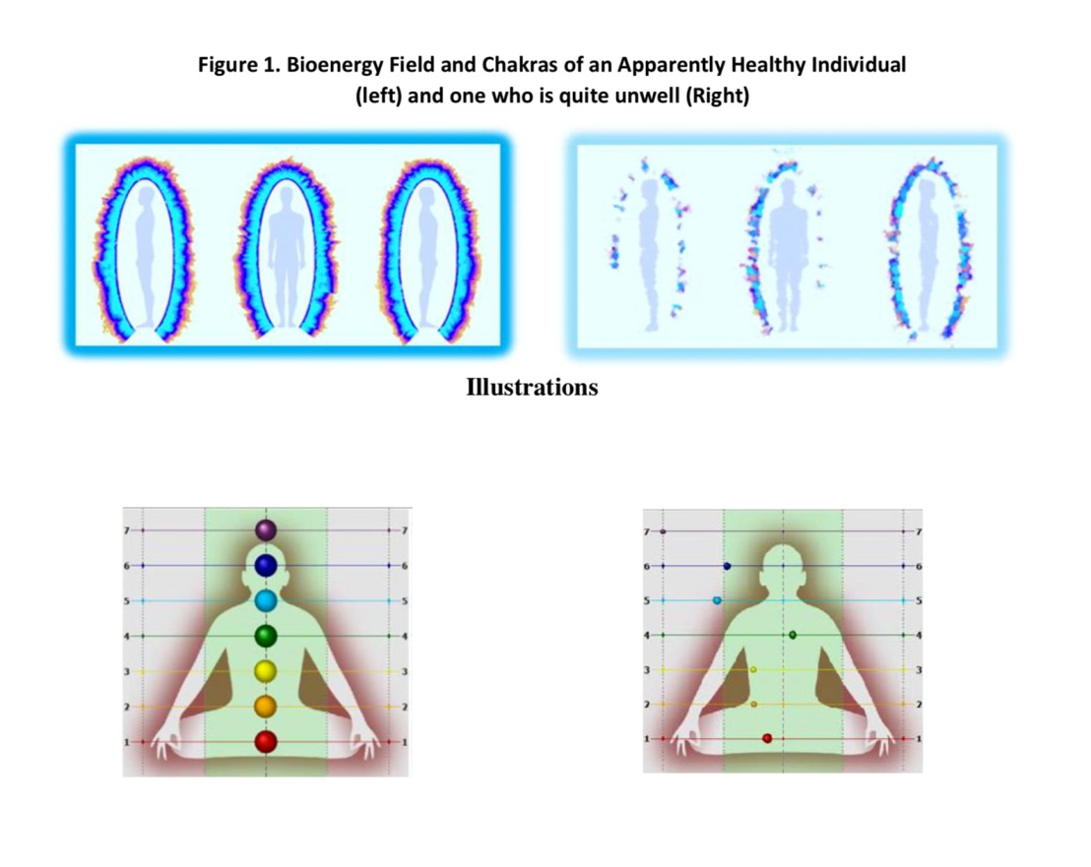
Yoga for Depression, Anxiety, and Other Health Concerns
There is an increasing interest in recent years in using yoga as an intervention for depression, anxiety, and various other health concerns (Manincor, et al., 2016).
Research in the West on the use of yoga for reducing depression began with a 1988 study by Berger and Owen (Berger & Owen, 1998), and in the past ten years, the numbers of empirical studies have grown (Louie, 2014).
Image courtesy of: https://gdvcamera.com/yoga-bioelectrography-research-the-science-of-yoga/

Slide 13

In a 6-week individualized study, Manincor and colleagues (2016) assessed the reduction of symptoms of depression and anxiety in participants along with associated increases in wellbeing and mental health. Yoga practices were tailored to individual needs and results showed that in addition to regular care, yoga was “effective in the reduction of symptoms of depression when compared with regular care alone” (Manincor, et al., 2016, p. 822).
A growing body of research indicates that yoga may offer mental health benefits via the hypothalamic-pituitary-adrenal (HPA) axis and the sympathetic nervous system (Bussing et al., 2012).
Image courtesy of: https://isha.sadhguru.org/yoga/
yoga-for-beginners/how-to-start-a-yoga-practice

Slide 14
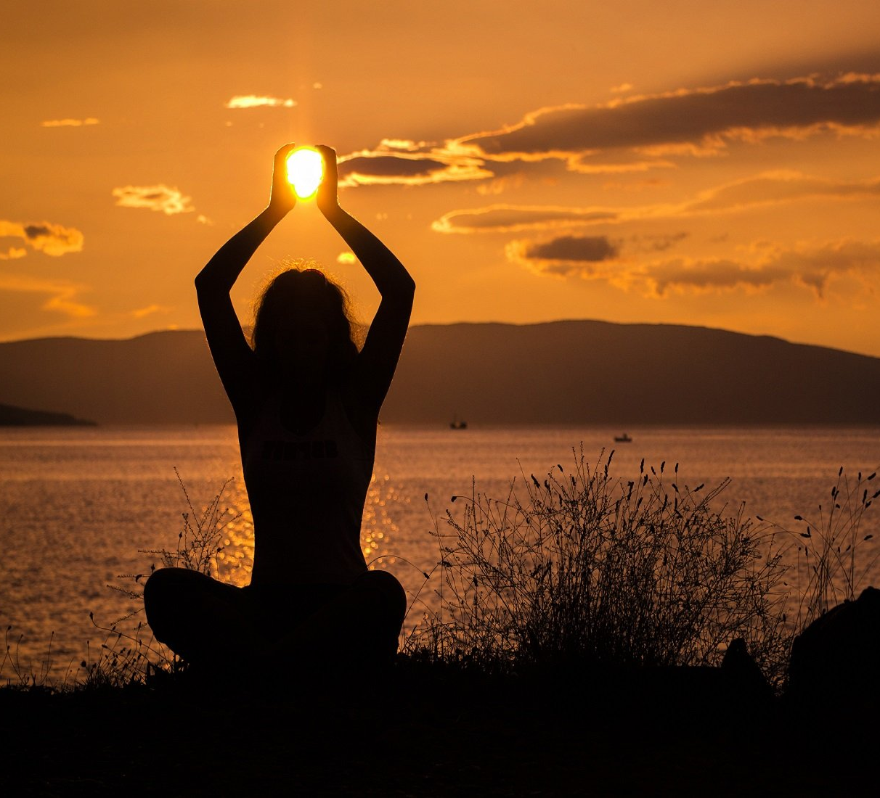
Yoga is effective
In a critical literature review on the effects of yoga asana on depression, Louie (2014) reported that collectively, the studies considered demonstrate that yoga is a safe, cost-effective, and popular method for ameliorating depression and that it can be used effectively as an adjunct to medication.
While further research is needed, “given the general interest and increased popularity and availability of yoga throughout the world” yoga may be both “effective and appealing” for individuals living with symptoms of depression and anxiety (Manincor, et al., 2016, p. 825).

Slide 15

Indigenous Approaches to Trauma and Depression
While “Indigenous strategies are most successful in supporting Indigenous individuals, families, and communities”, practitioners of all walks of life can be inspired by these strategies and incorporate them into their practices (Linklater, 2014, p. 132).
While mainstream approaches compartmentalize, Indigenous approaches are based in connection and in “the context of relationships with Creation” (Linklater, 2014, p. 133).
In the Indigenous approach, there is no set system of healing, instead it is believed that the answers for healing lie within each individual in need of healing. It is the healers’ role to help draw out the answers (Linklater, 2014).
Image courtesy of: http://traumahealingguru.com/
indigenous-healing-seeking-safety/

Slide 16
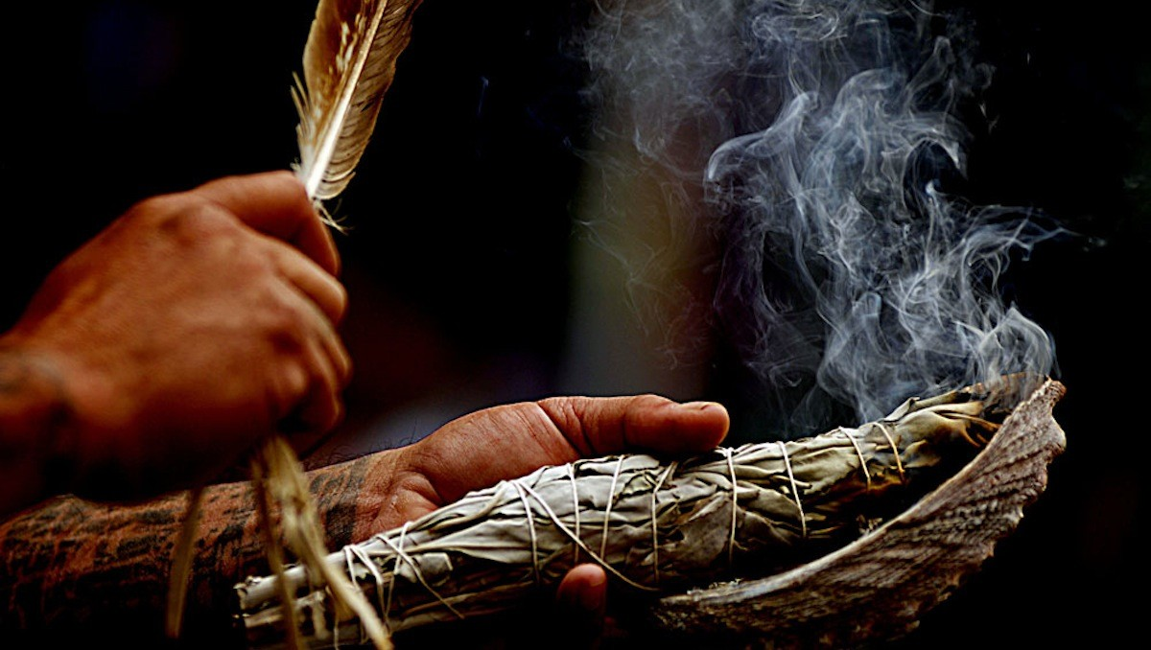
Prayer and Spiritual Connection
Prayer is considered to be a powerful aspect of healing, one that healers and psychologists can help their clients with (Gone, 2010).
Prayer, often done in conjunction with ceremonial offerings of tobacco and smudge, is considered essential in helping clients to feel better connected and less troubled (Linklater, 2014).
Establishing and maintaining a sense of connection to Spirit or a higher power is considered an essential part of healing (Linklater, 2014).
Image courtesy of: https://www.thesacredscience.com/the-art-of-smudging/

Slide 17

Love and Relationships
In Indigenous healing approaches, there is the recognition that love heals, and that love itself is medicine (Bent, 2004). Bent (2004) asserts that, love is one of the sacred teachings of the Elders.
Relationships are a key component of Indigenous approaches to healing and wholeness with its emphasis on the “importance of connection to others and to Creation” (Linklater, 2014, p. 135).
“Being in relationship is the manifest spiritual ground of Native being. In traditional perception, nothing exists in isolation, everything is relative to every other being or thing” (Couture, 1991, p. 59).
Image courtesy of: https://www2.gov.bc.ca/gov/content/careers-myhr/job-seekers/about-competencies/indigenous-relations

Slide 18
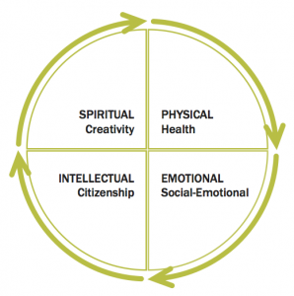
Cultural and Ceremonial Resources
In Indigenous culture, various forms of education have long brought both learning and healing to the people (Linklater, 2014). Sharing knowledge is considered to be a crucial role of Indigenous health care providers (McCormick, 2009).
Counsellors provide tools and strategies that help clients to develop and nurture “healthy, balanced, and culturally connected lifestyles” (Linklater, 2014, p. 137).
Indigenous approaches to trauma and depression take into account the four fundamental aspects of the self: physical, mental, emotional, and spiritual, and work to restore the individual on all levels (Linklater, 2014).
Image courtesy of: https://peopleforeducation.ca/
report/indigenous-education-2016/

Slide 19

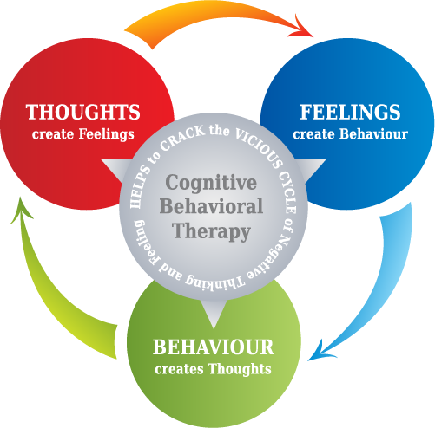
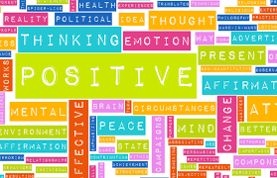
Other Therapeutic Interventions
Cognitive Behavioural Therapy
Involves addressing cognitive distortions (Wedding & Corsini, 2014)
Narrative Therapy
Emphasis on stories developed as an expert in our own lives (Roemer & Orsillo, 2009)
Positive Psychotherapy
Focuses on character strengths (Wedding & Corsini, 2014)
Acceptance and Commitment Therapy (ACT)
Acceptance and mindfulness methods along with cognitive and behavioural processes (Stoddard & Afari, 2014)
Image courtesy of: http://blogs.ubc.ca/qualresearch/narrative-and-social-change/narrative-therapy/
Image courtesy of: http://www.beatthewinterblues.info/is-cognitive-behavioral-therapy-useful-in-beating-the-winter-blues/
Image courtesy of: https://www.alliedtravelcareers.com/blog/cognitive-behavioral-therapy-techniques-for-improving-self-esteem/

Slide 20
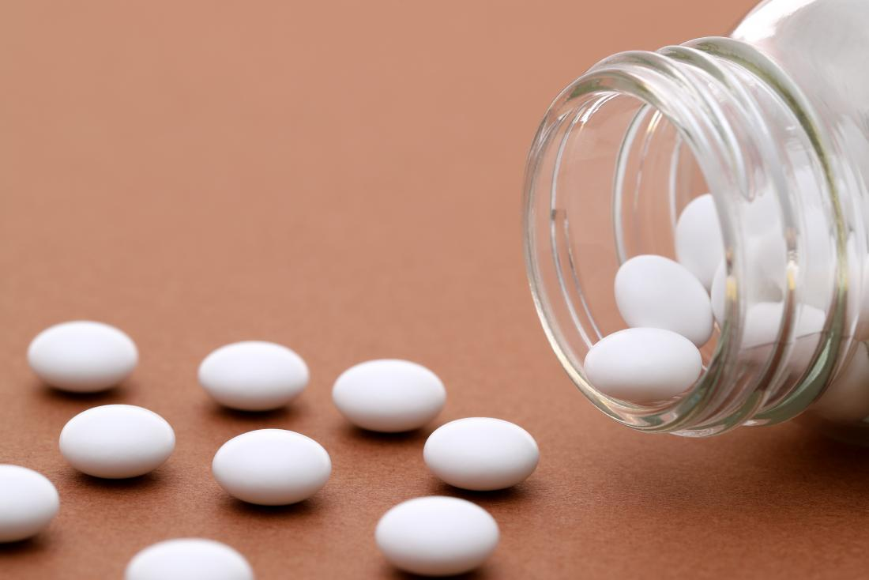

Conclusion
Mindfulness strategies are accessible to find and partake in as their popularity continues to grow globally
You can practice yoga, deep breathing, and meditation in the comfort of your own home and in community settings
Although mindfulness-based strategies are becoming more common, the most popular treatments for depression and anxiety are primarily pharmaceutical medications and therapeutic inventions.
Image courtesy of:
https://www.medicalnewstoday.com/kc/antidepressants-work-248320
Image courtesy of: http://phaitebehavioral.com/individual-therapy/

Slide 21
Discussion Questions
Considering the spiritual origins of yoga and meditation, what role do you see spirituality and traditional religious practices playing in counselling?
What tools and/or practices have you tried to manage your own stress, anxiety, or depression? How does your personal experience affect your approach with your clients?
How is mindfulness part of your self-care? Do you implement any mindfulness based stress reduction techniques in your routines or encourage clients to partake in them?

Slide 22
References
Bent, K. (2004). Anishinaabe ik-we mino-aie-win: Aboriginal women’s health issues: A holistic perspective on wellness: Summary report. University of Athabaska, Alberta, and Winnipeg, Manitoba: Prairie Women’s Health Centre of Excellence.
Berger, B. G., & Owen, D. R. (1988). Stress reduction and mood enhancement in four exercise modes: Swimming, body conditioning, hatha yoga and fencing. Research Quarterly for Exercise and Sport, 59, 148–159.
Bohlmeijer, E., Prenger, R., Taal, E., & Cuijpers, P. (2010). The effects of mindfulness-based stress reduction therapy on mental health of adults with a chronic medical disease: A meta- analysis. Journal of Psychosomatic Research, 68(6), 539-544. https://www-sciencedirect-com.ezproxy.lib.ucalgary.ca/science/article/pii/S0022399909004152 .
orchardt, A., & Zoccola, R. (2018). Recovery from stress: An experimental examination of focused attention meditation in novices. Journal of Behavioral Medicine, 41(6), 836-849.
Campbell, T., Labelle, L., Bacon, S., Faris, P., & Carlson, L. (2012). Impact of mindfulness-based stress reduction (MBSR) on attention, rumination and resting blood pressure in women with cancer: A waitlist-controlled study. Journal of Behavioral Medicine, 35, 262–271.
Coppola, F. (2007). Effects of Natural Stress Relief Meditation on Trait Anxiety: A Pilot Study. Psychological Reports, 101(1), 130-134.

Slide 23
Couture, J.E. (1991). “Explorations in native knowing.” In J.W. Friesen (ed.). The cultural maze: Complex questions on native destiny in western Canada. Calgary, AB: Detselig Enterprises.
Craven, J. L. (1989). Meditation and psychotherapy. Canadian Journal of Psychiatry. 34(7), 648–653.
Galla, B. M., O'Reilly, G. A., Kitil, J. M., Smalley, S.L., & Black, D. S. (2015) Community-based mindfulness program for disease prevention and health promotion: Targeting stress reduction. American Journal of Health Promotion, 30(1), 36-41. https://journals-sagepub-com.ezproxy.lib.ucalgary.ca/doi/abs/10.4278/ajhp.131107-QUAN-567
Gone, J.P. (2010). Psychotherapy and traditional healing for American Indians: Exploring the prospects for therapeutic integration. The Counseling Psychologist, 38(2), 166-235.
James, AC., James, G., Cowdrey, FA., Soler, A., & Choke, A. (2018). Cognitive behavioural therapy for anxiety disorders in children and adolescents (Review). Cochrane Database of Systematic Reviews, 2, 1-105. DOI: 10.1002/14651858.CD004690.pub4.
Kabat-Zinn, J. (1990). Full catastrophe living: using the wisdom of your body and mind to face stress, pain and illness. New York, N.Y. : Delacorte Press.

Slide 24
Kornfield, J. (2008). The Wise Heart: A Guide to the Universal Teachings of Buddhist Psychology. New York, NY: Bantam Dell.
Krishnamurthy, M. N., & Telles, S. (2007). Assessing depression following two ancient Indian interventions: Effects of yoga and Ayurveda on older adults in a residential home. Journal of Gerontological Nursing, 33 (2), 17–23.
Kumara, H., & Kumar, V. (2016). Impact of cognitive behavioural therapy on anxiety and depression in adolescent students. Journal of Psychosocial Research, 11(1), 77-85.
Linklater, R. (2014). Indigenous strategies for helping and learning. In Decolonizing trauma work: Indigenous stories and strategies (pp.132-157). Winnipeg, MA: Fernwood Publishing.
Louie, L. (2014). The effectiveness of yoga for depression: A critical literature review. Issues in Mental Health Nursing. 35(4). DOI: 10.3109/01612840.2013.874062
Manincor, M. , Bensoussan, A. , Smith, C. A., Barr, K. , Schweickle, M. , Donoghoe, L. , Bourchier, S. & Fahey, P. (2016). Individualized yoga for reducing depression and anxiety, and improving well- 100being: A randomized controlled trial. Depression & Anxiety, 33, 816-828. doi:10.1002/da.22502 https://onlinelibrary-wiley- com.ezproxy.lib.ucalgary.ca/doi/full/10.1002/da.22502
McCormick, R. (2009). “Aboriginal approaches to counselling.” In L.J. Kirmayer and G.G. Valaskakis (eds.). Healing traditions: the mental health of Aboriginal peoples in Canada. Vancouver, BC: University of British Columbia Press.

Slide 25
Nagy, L. M., & Baer, R. A. (2017). Mindfulness: What Should Teachers of Psychology Know? Teaching of Psychology, 44(4), 353–359. https://doi.org/10.1177/0098628317727913.
Robins, C. J., Keng, S. L., Ekblad, A. G., & Brantley, J. G. (2012). Effects of mindfulness-based stress reduction on emotional experience and expression: A randomized controlled trial. Journal of Clinical Psychology, 68, 117–131.
Roemer, L., & Orsillo, S. (2009). Mindfulness- and acceptance-based behavioral therapies in practice. New York, NY: Guilford.
Romagnolo, S., & Ohrt, J. (2017). Using Narrative Therapy With Low-Income Middle School Students: A Model for School Counselors. Journal of Child and Adolescent Counseling, 3(1), 59-73.
Snaith, P. (1998). Meditation and psychotherapy. British Journal of Psychiatry. 173, 193–195
Stoddard, J. A., & Afari, N. (2014). The big book of act metaphors : a practitioner's guide to experiential exercises and metaphors in acceptance and commitment therapy. Retrieved from https://ebookcentral-proquest-com.ezproxy.lib.ucalgary.ca
Wedding, D., & Corsini, R.J. (2014). Current Psychotherapies. Belmont, CA: Cengage Learning.
Zeidan, F., Johnson, S. K., Diamond, B. J., David, Z., & Goolkasian, P. (2010). Mindfulness meditation improves cognition: Evidence of brief mental training. Consciousness and Cognition, 19, 597−605.
Zylowska, L., Ackerman, D. L., Yang

